Slide 1
Software Security
CSC 481/681/781
Principles of Computer Security
Ref: Textbook, Section 3.4

Slide 2
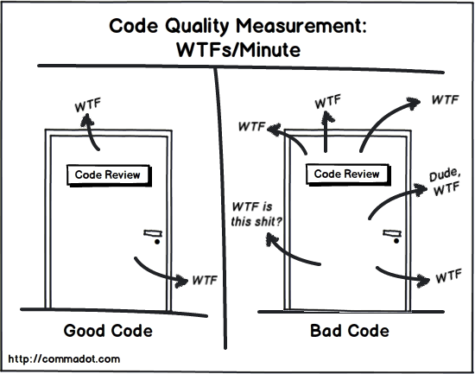
Terminology in Software Security
At a low level:
Apply secure coding practices during implementation
Conduct code reviews to identify potential vulnerabilities
Use static and dynamic analysis tools to detect security flaws
Perform testing techniques such as fuzzing and penetration testing
Fix vulnerabilities based on known patterns ((e.g., those in OWASP Top 10))
https://owasp.org/www-project-top-ten/

Slide 3

Common Vulnerabilities and Exposures
CVEs
Problem: How can people refer to specific vulnerabilities?
Solution: A reference numbering system
When vulnerabilities are found a number is applied for
All are listed in the “National Vulnerability Database” at NIST
Example: CVE-2022-38108 - notice:
Severity Metrics (CVSS) - including attack complexity, etc.
External links (includes an exploit in this case)
Vulnerability type (CWE: Common Weakness Enumeration)
See http://cwe.mitre.org/ (pay attention to the Top 25!!)
How many vulnerabilities are there? Recall Assignment 1!
See overview at https://nvd.nist.gov/general/nvd-dashboard
Be afraid - be very afraid….

Slide 4
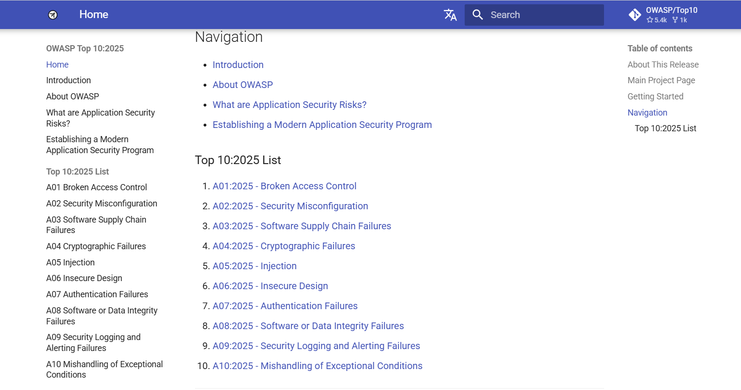
Common Vulnerabilities and Exposures
CVEs
https://owasp.org/Top10/2025/

Slide 5
What Types of Bugs are Most Common?
Using CVE and CWE evaluations
Limit to Ubuntu: Ubuntu Security Notices (cross-references w/CVEs)
Ubuntu stable releases:
 | Ubuntu 14.04 | Ubuntu 16.04 | Ubuntu 18.04
Released: | April 2014 | April 2016 | April 2018
1st year vuln | 701 | 1042 | 843
High/Critical vuln | 268 | 258 | 156
Buffer overflows | 31% | 39% | 30%
Permissions | 10% | 10% | 16%
Pointer issues | 3% | 9% | 11%
Input validation | 14% | 13% | 11%
Resource mgmt. | 9% | 5% | 9%
Numeric errors | 8% | 2% | 0.2%
Consistently
most common
type of error
Ref: S. R. Tate, M. Bollinadi, J. Moore. “Characterizing Vulnerabilities in a Major Linux Distribution,” in Proceedings of the 32nd International Conference on Software Engineering and Knowledge Engineering (SEKE), 2020, pp. 538-543. https://span.uncg.edu/vulnerabilities/

Slide 6
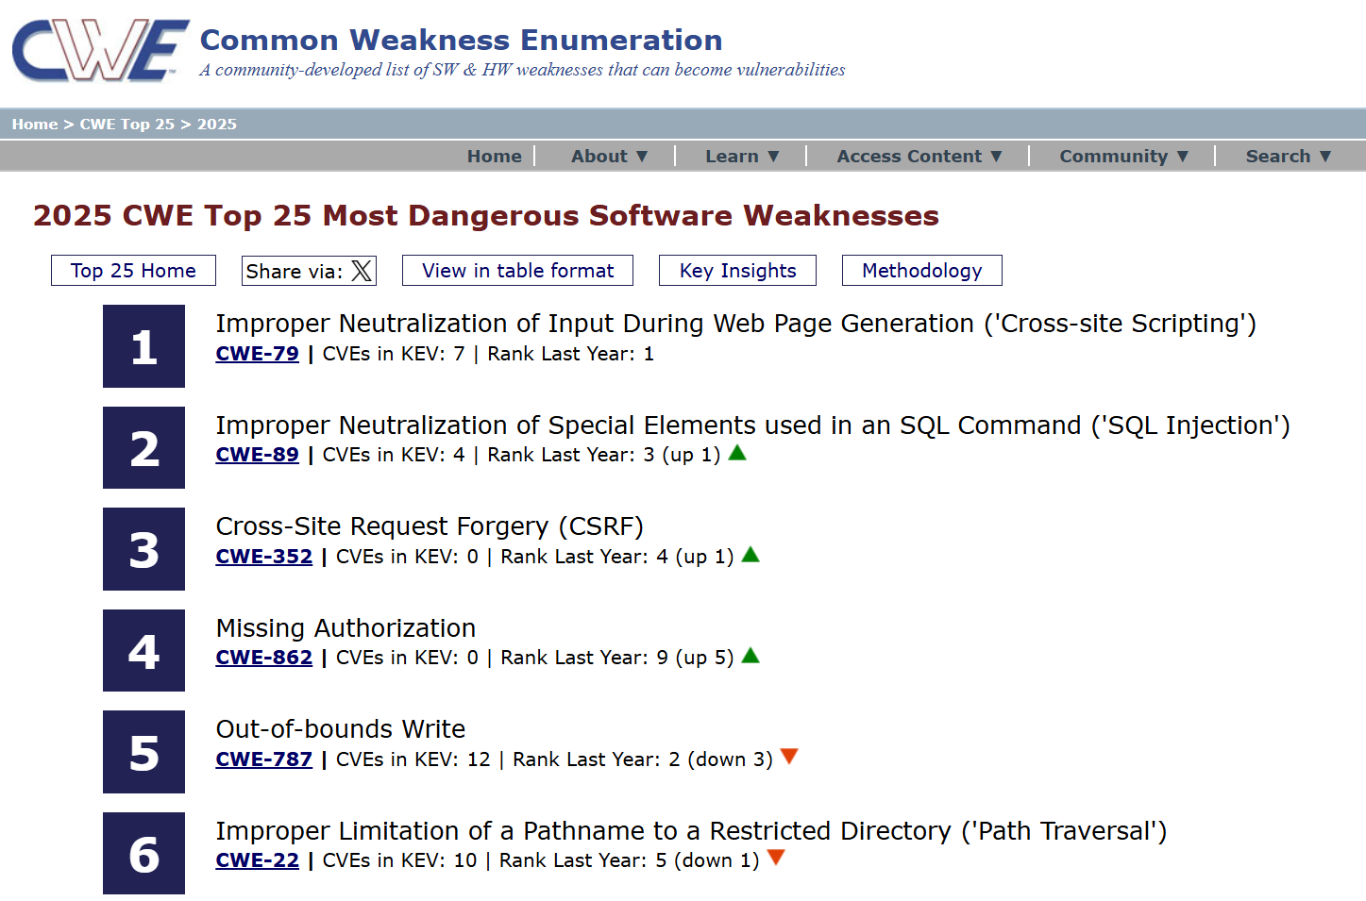
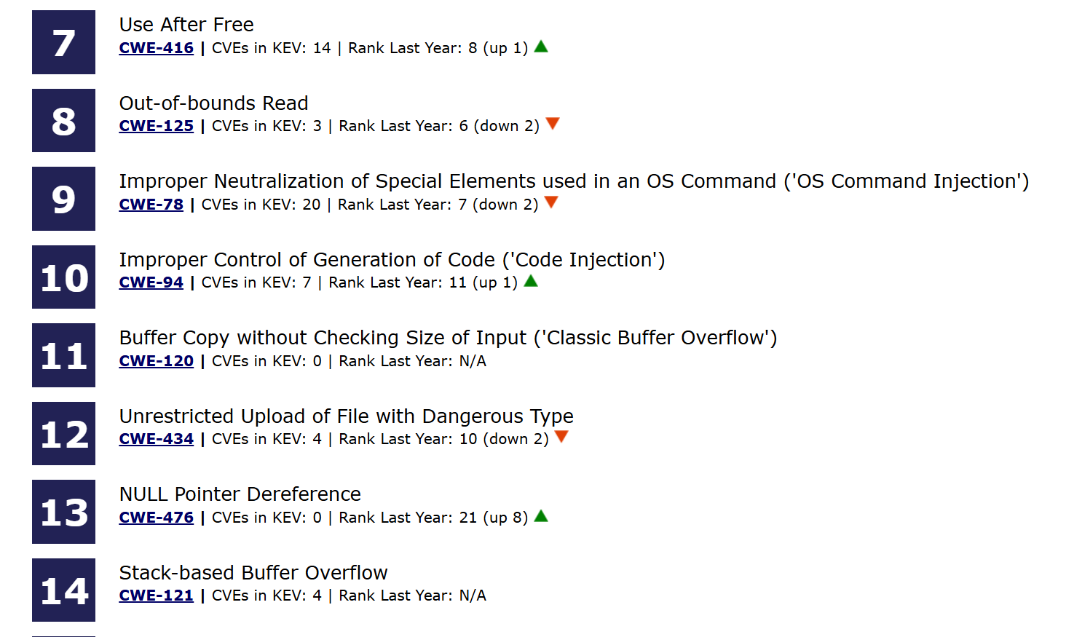
What Types of Bugs are Most Common?
Using CVE and CWE evaluations
2025 CWE Top 25 Most Dangerous Software Weaknesses
https://cwe.mitre.org/top25/archive/2025/2025_cwe_top25.html

Slide 7
Common software vulnerabilities
Buffer Overflow
Integer Overflow

Slide 8
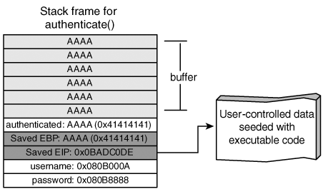
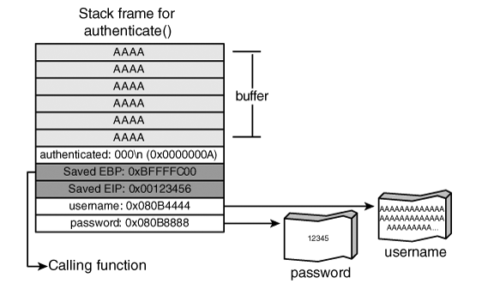
Common software vulnerabilities
Buffer Overflow

Slide 9
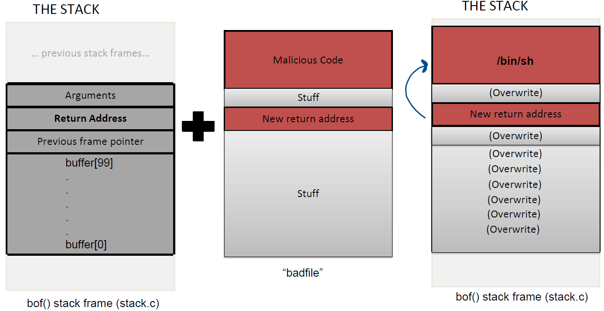
Common software vulnerabilities
Buffer Overflow - Stack Smashing Exploits
Concept | Meaning
Buffer overflow | Writing beyond buffer
Stack overflow | Overflow occurs on stack
Stack smashing | Exploiting it to hijack control

Slide 10
Stack Smashing Exploits
Two requirements for a classic stack smashing attack:
Attacker sends code (machine instructions) that are stored in memory where they can be executed
Attacker overwrites return address on the stack with the location of the attack code so that a function “returns” to the attack code

Slide 11
Stack Smashing Exploits Protections
Make it so uploaded information is non-executable data
Two requirements for a classic stack smashing attack:
Attacker sends code (machine instructions) that are stored in memory where they can be executed
Attacker overwrites return address on the stack with the location of the attack code so that a function “returns” to the attack code
Don’t return if return address has been overwritten
Make it so attacker doesn’t know location of attack code

Slide 12
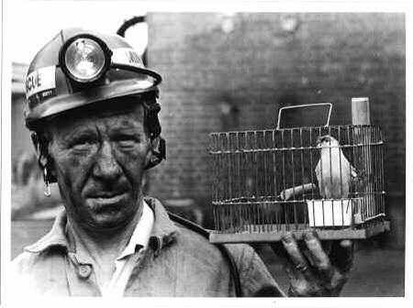
Protection 1
Don’t return if return address has been overwritten
Real problem: detecting if return address has been overwritten
Two proposed solutions:
Canary
Write-protect memory to monitor writes
Crispin Cowan, Carlton Pu, Dave Maier, Jonathan Walpole, Peat Bakke, Steve Beattie, Aaron Grier, Perry Wagle, Qian Zhang, and Heather Hinton. StackGuard: Automatic Adaptive Detection and Prevention of Buffer-Overflow Attacks, Proceedings of the 7th USENIX Security Symposium, 1998.

Slide 13
Protection 1
Don’t return if return address has been overwritten
Canary idea:
Important points:
Buffer overflows (typically) overwrite a contiguous block of memory starting at buffer
No way to get to return address without also overwriting canary
Canary value chosen randomly before function is called (unpredictable)
Canary value checked before function returns
Exit program if canary died
Very influential idea that is common across all systems now:
-fstack-protector option to gcc
/GS option to Microsoft C compiler
(Typically enabled by default now…)
Return Address
Canary (value unknown to attacker)
… other stuff ...
Buffer that can overflow

Slide 14
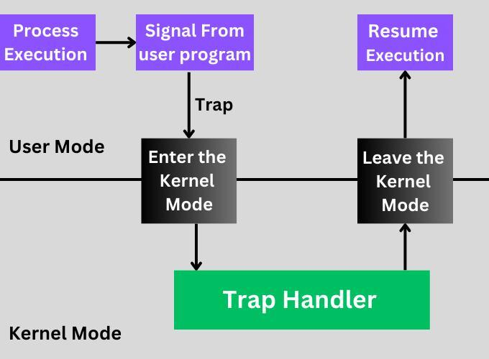
Protection 1
Don’t return if return address has been overwritten
Write-protecting values - use HW features to stop writes to return address
Method 1: Write protect memory page that has return address
Attempts to write cause trap to kernel
Kernel can check if it’s an allowed write or not
Problem: Very (very!) slow to trap on all writes
Method 2: Use debug registers to detect sensitive writes
Problem: Only a small number of address trap registers
Can pad stack frames so only 4 stack frames on a page
Non-active pages protected with method 1
Note: Due to inefficiency, better used for testing than run-time protection.

Slide 15
Protection 2
Make it so uploaded data is non-executable data
Idea: Make pages that attackers can write to non-executable
Commonly applied to stack and possibly the heap
Many abbreviations from HW vendors and OS makers:
AMD processors calls this the “NX” bit
Intel calls this XD (eXecute Disable)
Microsoft Windows support is DEP (Data Execution Prevention)
Linux calls it NX
Good idea, but isn’t as effective as you’d think...

Slide 16
Return-Oriented Programming (ROP)
Working around non-executable stacks (“return-to-libc”)
Idea: If attacker can’t upload code to execute, can the code be found already loaded into the process?
A few machine instructions that do something helpful, then ret
Called a “gadget” (or a “ROP gadget”)
Can execute the gadget just by setting return address
Surprisingly easy to find useful gadgets
On the heap can overwrite virtual function tables (avoids canaries)
Sequence of return addresses on stack for multi-step ROP:
“/bin/sh”
Gadget 3: Calls system()
Gadget 2: Subtracts 16 from RDI
SP
Gadget 1: Moves RSP to RDI and ret

Slide 17
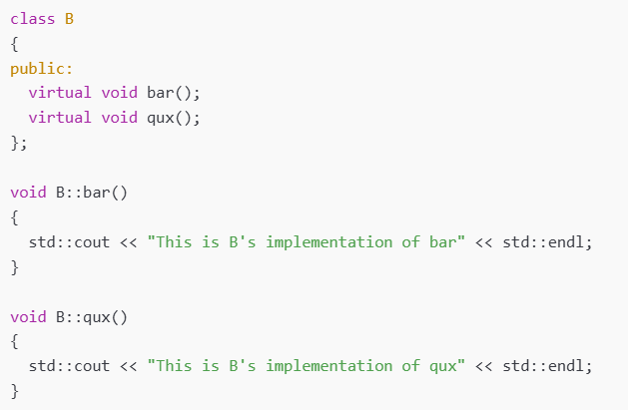
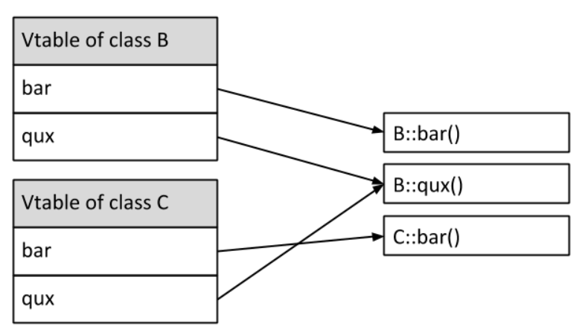
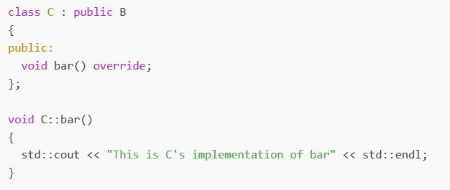
Return-Oriented Programming (ROP)
Working around non-executable stacks (“return-to-libc”)

Slide 18
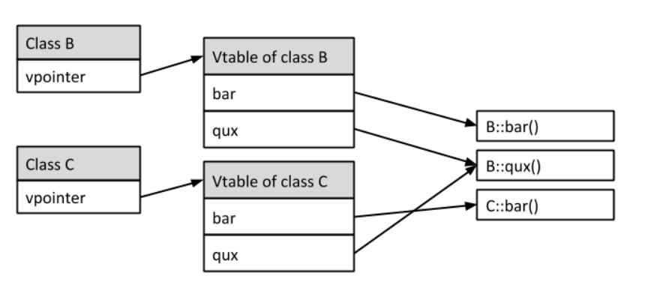
Return-Oriented Programming (ROP)
Working around non-executable stacks (“return-to-libc”)

Slide 19
Protection 3
Make it so attacker doesn’t know address of attack code
Idea: Randomize mem layout so attacker doesn’t know what to set ret addr to!
Address Space Layout Randomization (ASLR)
On Windows:
Relocates code/libraries when they are loaded
But then all processes sharing libraries use the same address
On Linux:
Uses PIC (Position Independent Code)
Location can be different in different processes!
Unfortunately: A little slower (uses a register - big deal for 32-bit Intel CPU)
Control with /proc/sys/kernel/randomize_va_space

Slide 20
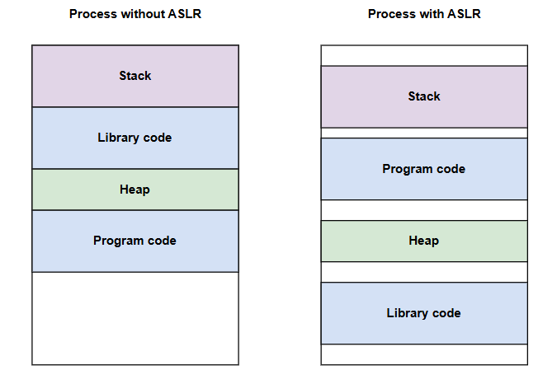
Protection 3
Make it so attacker doesn’t know address of attack code

Slide 21
Protection 3
Make it so attacker doesn’t know address of attack code
Address Space Layout Randomization (ASLR) in Linux
Level | Description
0 | No randomization (ASLR disabled)
1 | Partial randomization: stack, shared libraries, mmap(), and VDSO
2 | Full randomization: includes heap in addition to Level 1
Enable Full ASLR (Level 2)：
sudo bash -c "echo 2 > /proc/sys/kernel/randomize_va_space"

Slide 22
Protection 3
Make it so attacker doesn’t know address of attack code
Address Space Layout Randomization (ASLR) in Linux
Demo: C++ Example: Printing Memory Segment Addresses

Slide 23
Avoiding Buffer Overflows
Best way to stop exploits is to eliminate the vulnerabilities
Lots of dangerous functions in C - avoid them!
Unbounded I/O operations like gets(), scanf(), ...
Unchecked string ops: strcpy(), strcat(), sprintf(), ...
Conventional wisdom: No buffer overflows in Java or Python
Not true! No stack smashing take-overs, but can still overflow buffers
Java: Throws “IndexOutOfBoundsException”
Python: Throws “IndexError” exception
So: Turns it from system compromise to DoS, but still a problem
Functional programming languages/patterns are less dangerous
Traditional functional languages (ML, Haskell, …) can be slow
Rust is a newish language with functional constructs and high performance
Goal is C-like performance with more safety
Benchmarks very competitive with C
“Most loved language” 8 yrs (2016-2023) in StackOverflow developer survey
They don’t limit how much data is read
They don’t check buffer size

Slide 24
Common software vulnerabilities
Integer Overflow - Data Type in C/C++

Slide 25
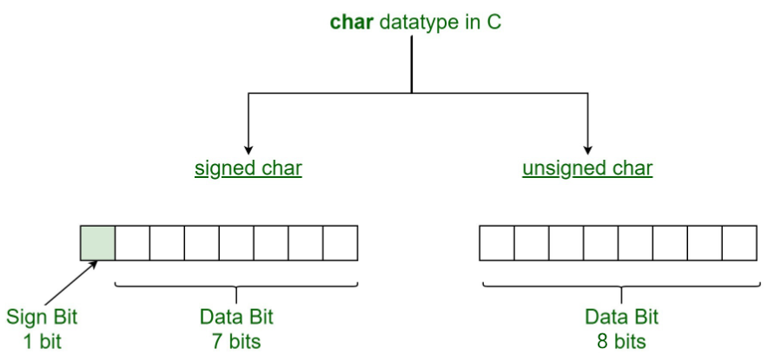
Common software vulnerabilities
Integer Overflow – Signed/Unsigned Integer

Slide 26
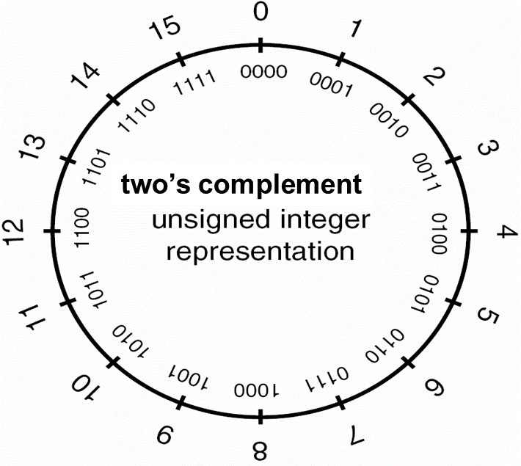

Common software vulnerabilities
Integer Overflow – Unsigned Integer
Unsigned integer values range from zero to a maximum that depends on the size of the type.
This maximum value can be calculated as $2^{n}−1$, where n is the number of bits used to represent the unsigned type.
For example:
4-bit unsigned integer representation:
0 to $2^{4}−1$ (0 to 15)

Slide 27
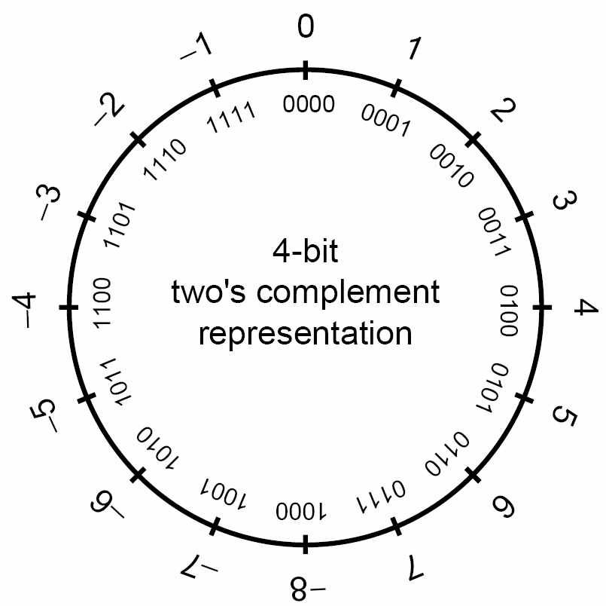

Common software vulnerabilities
Integer Overflow – Unsigned Integer
Signed integers are used to represent positive and negative values.
On a computer using two’s complement arithmetic, a signed integer ranges from $−2^{n−1}$ through $2^{n−1}−1$
For example:
4-bit two’s complement representation:
${−2}^{4−1}$to $2^{4−1}−1$ (-8 to 7)

Slide 28
Common software vulnerabilities
Integer Overflow – Unsigned Integer
For example:
8-bit unsigned integer:
Max: 1111 1111 = 255
Min: 0000 0000 = 0
8-bit signed integer:
Max: 0111 1111 = 127
Min: 1000 0000 = -128

Slide 29
Integer Overflow
Too big for a register...
Question 1: In a system with 32-bit signed integers, what do you suppose 1,000,000,000 + 2,000,000,000 is?
Question 2: In a system with 32-bit signed integers, what do you suppose 4,294,958 * 1000 is?

Slide 30
Integer Overflow
Too big for a register...
Question 1: In a system with 32-bit signed integers, what do you suppose 1,000,000,000 + 2,000,000,000 is?
Answer: -1,294,967,296
Question 2: In a system with 32-bit signed integers, what do you suppose 4,294,958 * 1000 is?
Answer: 704
This is called integer overflow： Simple arithmetic on a variable, such as addition, subtraction, or multiplication, can result in a value that can’t be held in that variable.

Slide 31
Integer Overflow
Too big for a register...
Integer Overflow Risks
If an integer overflow happens when you calculate the length of a buffer, you may end up with a buffer overflow. A buffer overflow lets the attacker gain shell access and attempt further privilege escalation.
For example:
Program says “I’d like enough memory for 4,294,958 objects of size 1000”
CPU does the multiplication and actually allocates just 704 bytes.
Just writing to the second object would be past the end of the buffer!

Slide 32
Integer Overflow
Too big for a register...
Integer Overflow Risks
If an integer overflow happens during financial calculations, it may, for example, result in the customer receiving credit instead of paying for a purchase or may cause a negative account balance to become positive.

Slide 33
Integer Overflow
A real example...
This is CVE-2018-12264 - a buffer overflow in exiv2 (an image tag-processing library)
CVSS v3.0 Severity and Metrics -- Base Score: 8.8 HIGH
Common characteristic to notice: Mixing data of different sizes (32-bit and 64-bit here)
Many of these bugs are “hold-overs” from code that was fine for 32-bit processors...
Two 32-bit values are pulled out of the (attacker provided) file and saved as 32-bit unsigned integers. Can be any 32-bit value - no checking.
In file src/preview.cpp:
801 uint32_t offset = dataValue.toLong(0);
802 uint32_t size = sizes.toLong(0);
803 if (offset + size <= static_cast<uint32_t>(io.size()))
804 dataValue.setDataArea(base + offset, size);
offset + size can overflow a uint32_t and wrap around, so it looks small
dataValue.setDataArea accesses memory (makes a copy) at address of 1st argument
On a 64-bit machine, this is a 64-bit addition, so doesn’t wrap around when uint32 did
Exploit had offset=0xfffffff7 and size 0x59
So “offset+size” in 32 bits gives 0x50 - well within buffer
But base+offset as 64-bit add goes approx 4GB past end of buffer

